Slide 1
Empower 3 FR3 Licensing for Shimadzu and Hitachi Systems
For Internal Use
Do Not Distribute

Slide 2
Update on Shimadzu & Hitachi
On November 1, 2015, Shimadzu discontinued sales of Waters Empower Software as a solution with their LC or GC systems
The relationship with Shimadzu was not successful as they continued to sell and enhance their internally developed LabSolutions product as an alternative to Empower
Concerns that the Shimadzu team was exploiting the relationship with Waters to access our Empower network customers
Based on this change in relationship we add the appropriate license controls to ensure customer were licensed through Waters appropriately
Hitachi continue to offer Waters Empower as their only CDS solution
The Waters Japan team has a very good relationship with Hitachi and does not see them as a direct competitor

Slide 3
Impact to the customers
Customers could have purchased directly from Waters or purchased directly from the instrument vendor:
Customers who purchases their Hitachi LC, Shimadzu LC or Shimadzu GC Control Licenses directly from Waters can leverage the serial numbers included on the associated license certificate for license activation.
For customers who purchased system control directly from Hitachi, contact Hitachi to secure the Empower 3 Feature Release 3 upgrade and the appropriate Hitachi control licenses.
For customers who purchased system control directly from Shimadzu, Waters offers a trade-in program to secure the appropriate Waters license certificate. Customers who purchased system control from Shimadzu will be required to provide proof of purchase prior to November 1, 2015 to be eligible for this trade-in program.

Slide 4
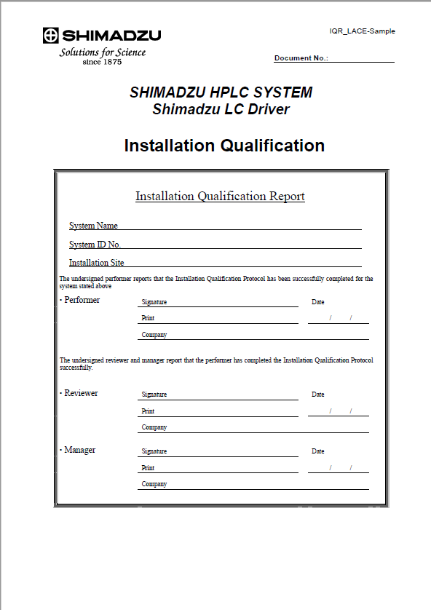
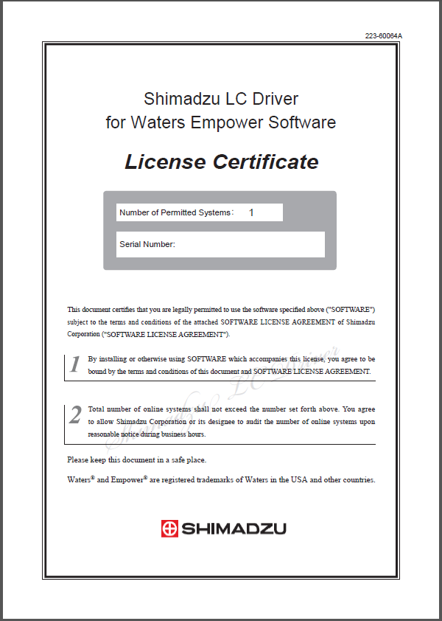
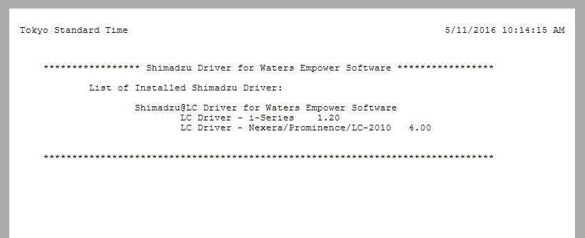
Trade-in Process for Customer who purchased driver from Shimadzu
Customer must have an active Empower Support Plan to order Empower 3 Feature Release 3 media
Customer must supply one license certificate with unique serial number for each Shimadzu LC and GC system controlled by Empower
Customer must supply documentation that license was purchase or installed prior to November 1, 2015
Installation Qualification Report
Or
Verification Test Report
Or
Shimadzu Purchase order
+

Slide 5
Shimadzu Date Verification
Shimadzu Installation Qualification Report
When the Shimadzu engineer performs a IQ for the Shimadzu system the complete an IQ Report which included the date the qualifications was performed.
Shimadzu Verification Test Report
In the event the Shimadzu engineer did not perform an IQ for the Shimadzu system, they typically perform a verification test creating a Verification Report which also includes the date the test was performed.

Slide 6
Trade-in Process for Customer who purchased driver from Shimadzu
Customer completes form to request Empower 3 FR3
Customer should leverage existing licenses
Purchase through Waters
Yes
Active
Software
Plan?
Yes
Shimadzu Systems Installed
No
Ship Software
Purchase through Shimadzu
Software Plan required to receive upgrade
Yes
No
Renew
Software Plan
Supply
License Docs
Yes
Ship Software & Licenses
Must supply document for each system
No
Purchase New Shimadzu Control Licenses

Slide 7
What’s Needed
Upgrade license to facilitate the “No Charge” trade-in program
Add a statement on the Upgrade Request web page with instructions to include appropriate Shimadzu documentation for control purchased through Shimadzu
Add a checkbox on the Empower 3 FR3 Request Form
Communicate with upgrade teams.
 | Sales P/N | Upgrade P/N
Shimadzu LC Control License | 176002764 | 667005550
Shimadzu GC Control License | 176002765 | 667005551
Hitachi LC Control License | 176003678 | 667005552

Slide 8
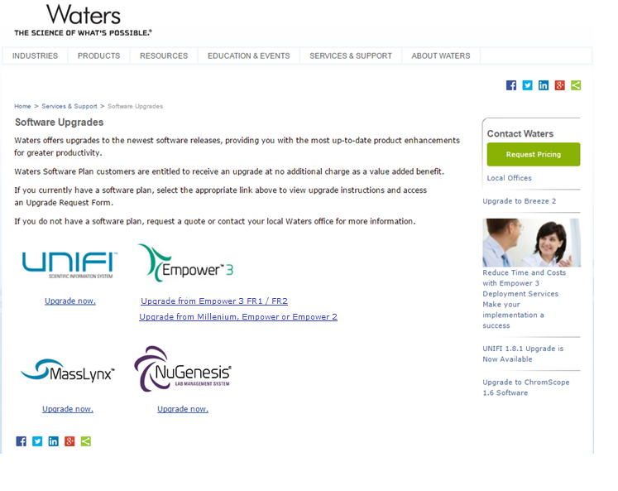
Upgrade Request Main Page http://www.waters.com/waters/en_US/Software-Upgrades/nav.htm?cid=10053564
Create /identify upgrade path on initial Software Upgrade Request Page

Slide 9
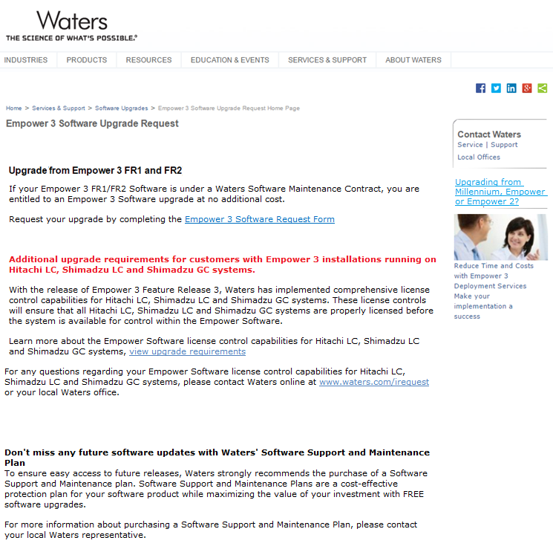
Upgrade from Empower 3 FR1 / FR2 (1) http://www.waters.com/waters/en_US/Empower-3-Software-Upgrade-Request-Home-Page/nav.htm?&cid=10183757
Simplify introduction w/ request form link
Callout alternative upgrade path
License Control Callout
Maintenance Support Reminder

Slide 10
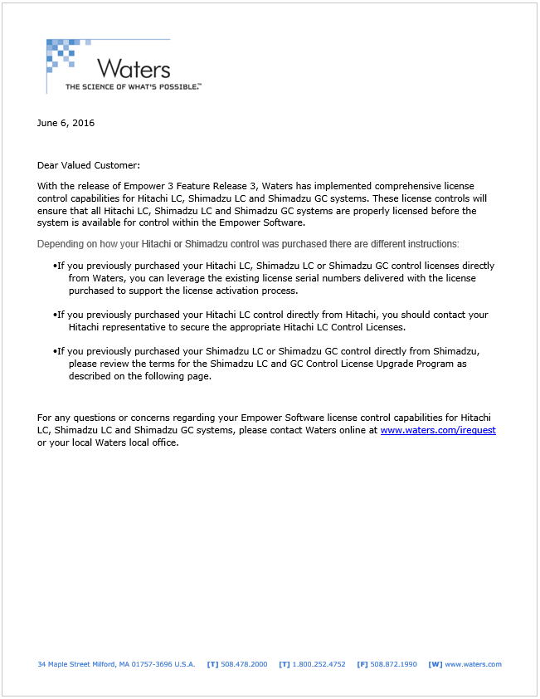
Upgrade Requirements

Slide 11
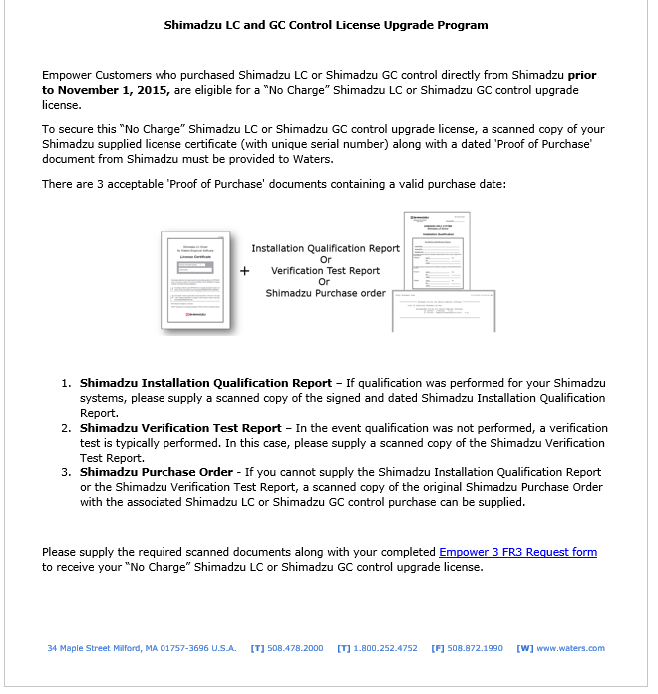
Upgrade Requirements

Slide 12
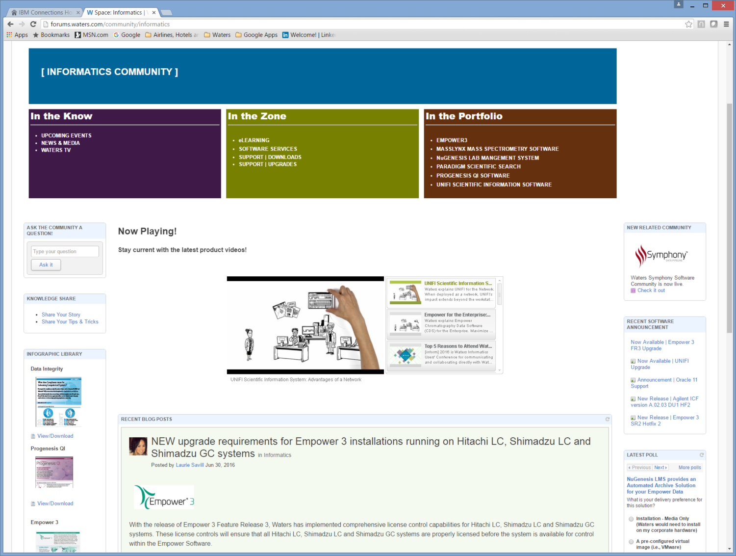
Announcement on eCommunity

Slide 13
License Changes in Release Notes
Changes to Shimadzu LC & GC Licenses are highlighted in the Empower 3 Feature Release 3 Release Notes
Located on Page 12 of the
Empower 3 FR3 Release Notes
Part Number 716004689rA

Slide 15
Backup Slides

Slide 16
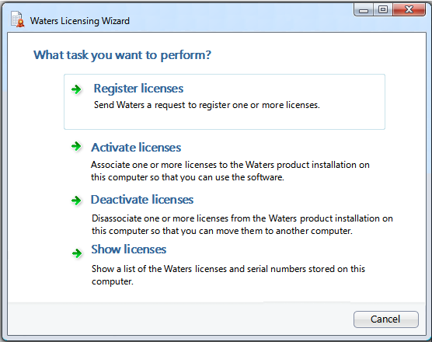
License Activation
License activation is a three step process
Request software registration – Wizard
Create License Request File
Web license activation – Waters License Activation Center
Provide contact information and serial numbers or order number
Upload License Request File to web
Generate License Activation File
Activate license – Wizard
Load License Activation File
Software is available for use

Slide 17
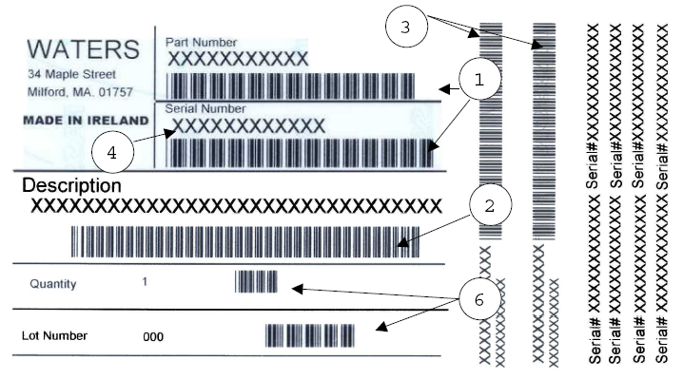
Waters Unique License Serial Numbers
All Software, Licenses and Options include serial numbers
Waters SAP system generates a unique 10+ character serial number for each software license
Serial numbers are placed on software media and paper license documentation
Serial numbers are scanned during the order shipment from distribution
Serial numbers are stored in SAP with the appropriate customer information
The license management system leverage the serial numbers stored in SAP

Slide 18
License Document w/ Serial Number

Slide 19
Licensing Process
Workstation
Network
Server
Registration file containing a
GUID: SMF123FT777BB789
Waters Activation
Web Site
Activation file containing same
GUID: SMF123FT777BB789

Slide 20
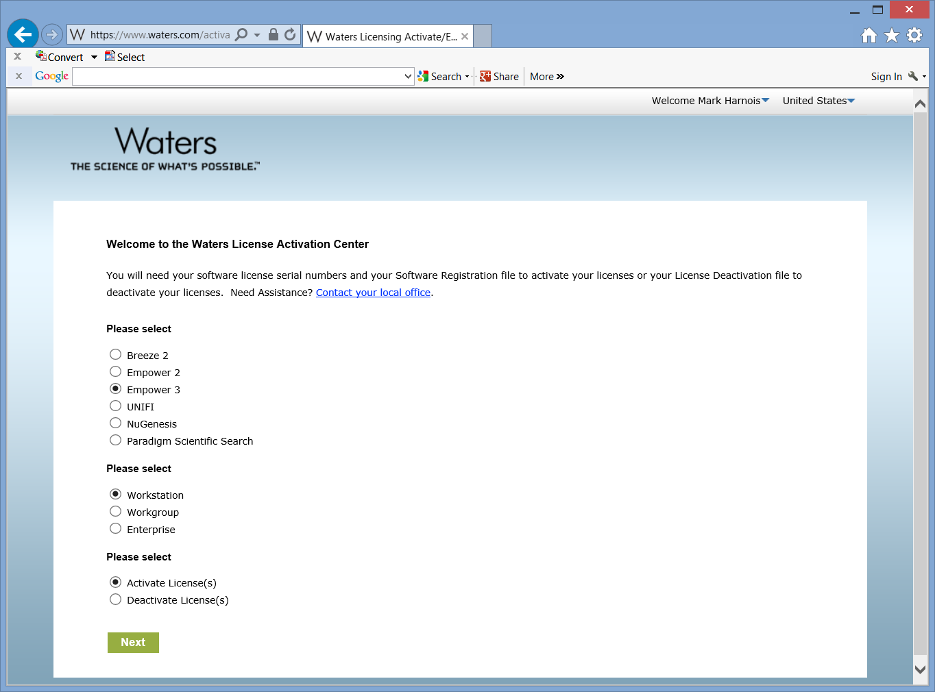
Activating new license
User selects Activate License(s) from the Welcome screen

Slide 21
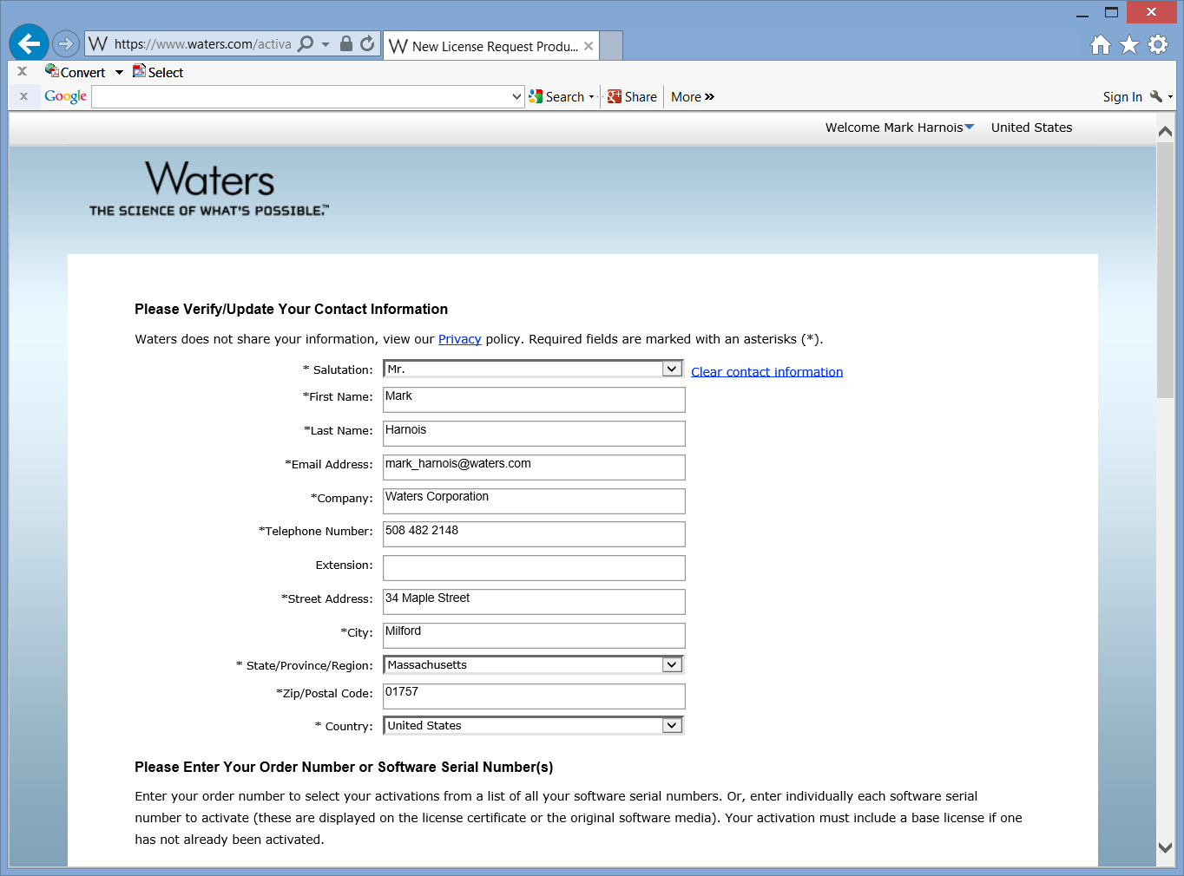

Slide 22
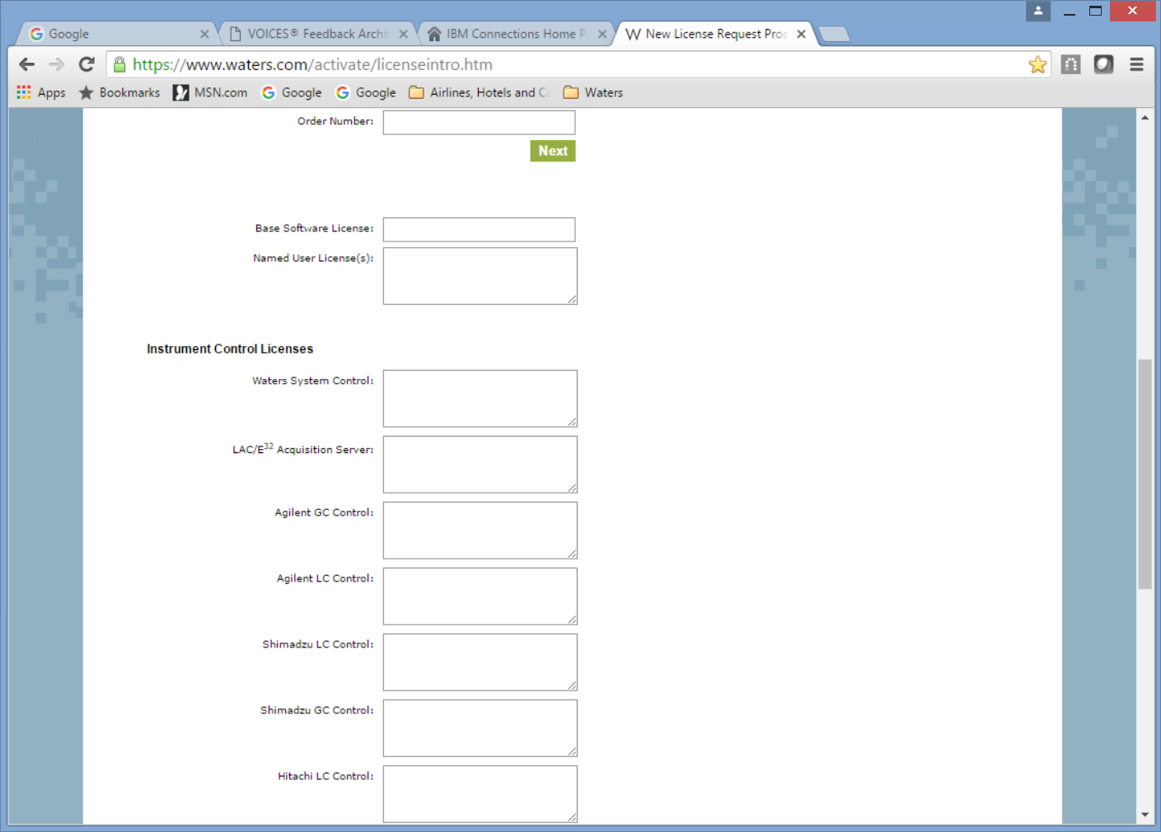

Slide 23
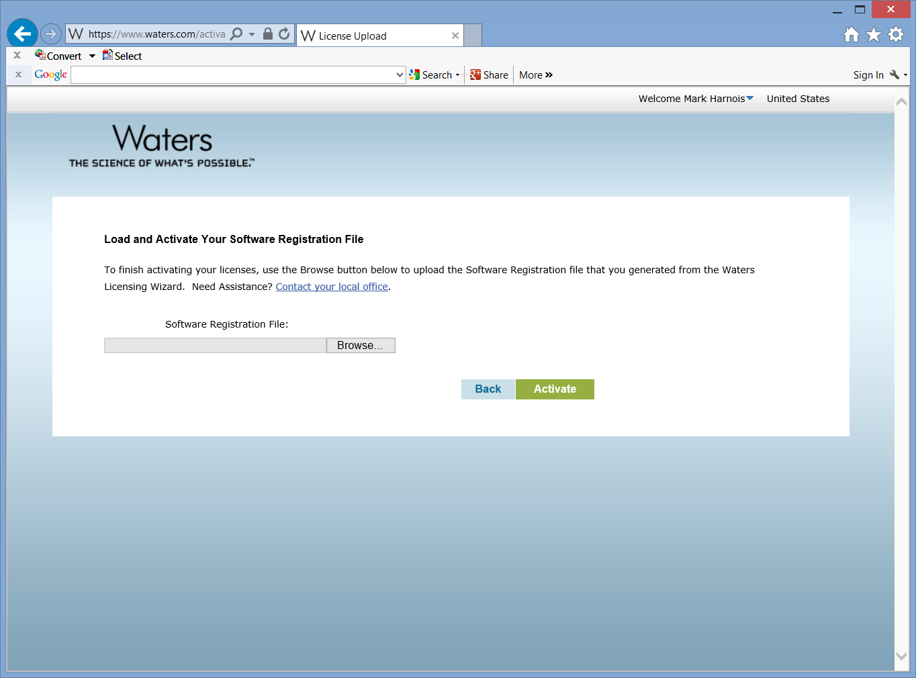

Slide 24
Activating new license
Same process for new license request or applying a new license to an existing installation

Slide 25
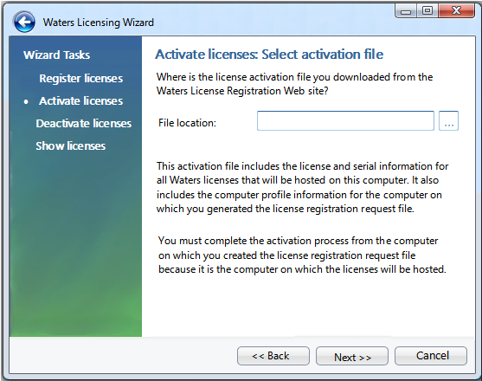
Activating new license
User is prompted to load License file generated during the web registration
License file include the Installation Profile generated during the license request. This unique system identifier is compared to ensure the license is installed on the same computer that started the process.

Slide 26
View current installed license
Select to display a list of installed licenses and serial numbers

Slide 27
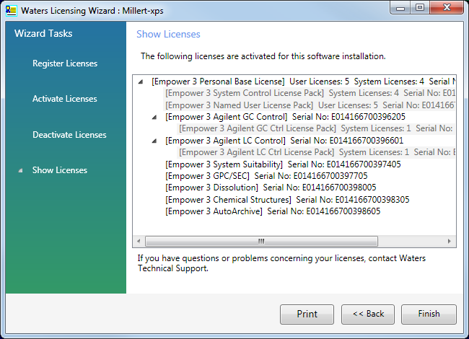
View current installed license
License Manage Wizard displays all licenses installed with serial numbers

Slide 28
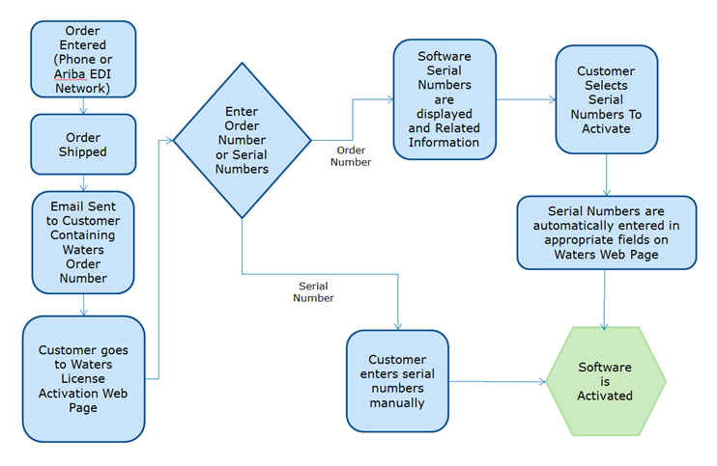
Waters Software Licensing
Waters Empower 3 License Process

